Slide 1


Can Computers Be
Conscious?
Topic：Computer
Reporter：Team 5
2025.12.11

Slide 2

1
Author and Background
2
Article Structure
CONTENTS
3
Vocabulary
4
Complex Sentences
5
Reading Skills

Slide 3
1
Author and Background

Slide 4


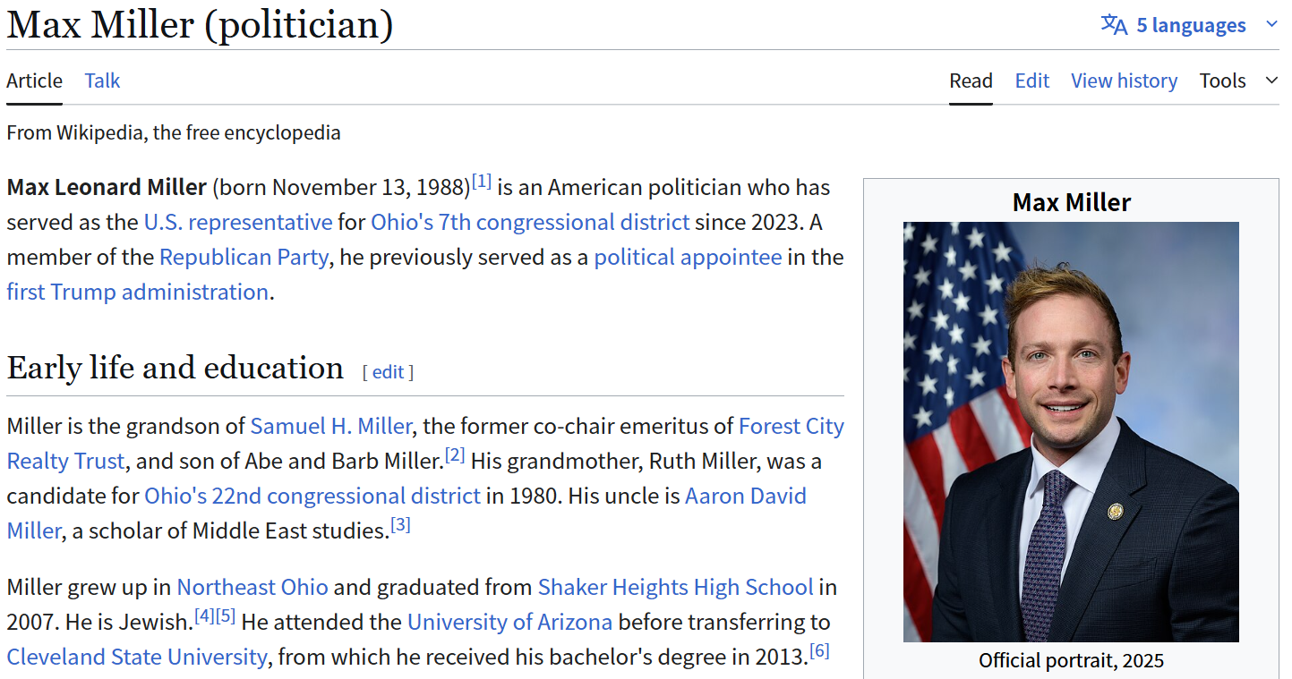
Author and Background
Article Structure
Vocabulary
Complex Sentences
Reading Skills
1.1 Author
Max Miller is Big Think's Assistant Managing Editor, in charge of setting daily content of the website and interviewing the illustrious experts that come through Big Think's studio. During his time at Big Think, he has had the pleasure to interview many of the world's thought leaders, including Malcolm Gladwell, Edward Norton, Garry Kasparov, Salman Rushdie, and Julian Schnabel.
Before becoming a Big Thinker, Max lived in Hanoi for a year, where stuffed himself on bun cha and served as the Associate Executive Editor of Vietnam Financial Review, the only independent English-language financial magazine in Vietnam.
Max graduated from Princeton University, where he received an A.B. in English.
https://bigthink.com/people/maxmiller/
5
01

Slide 5
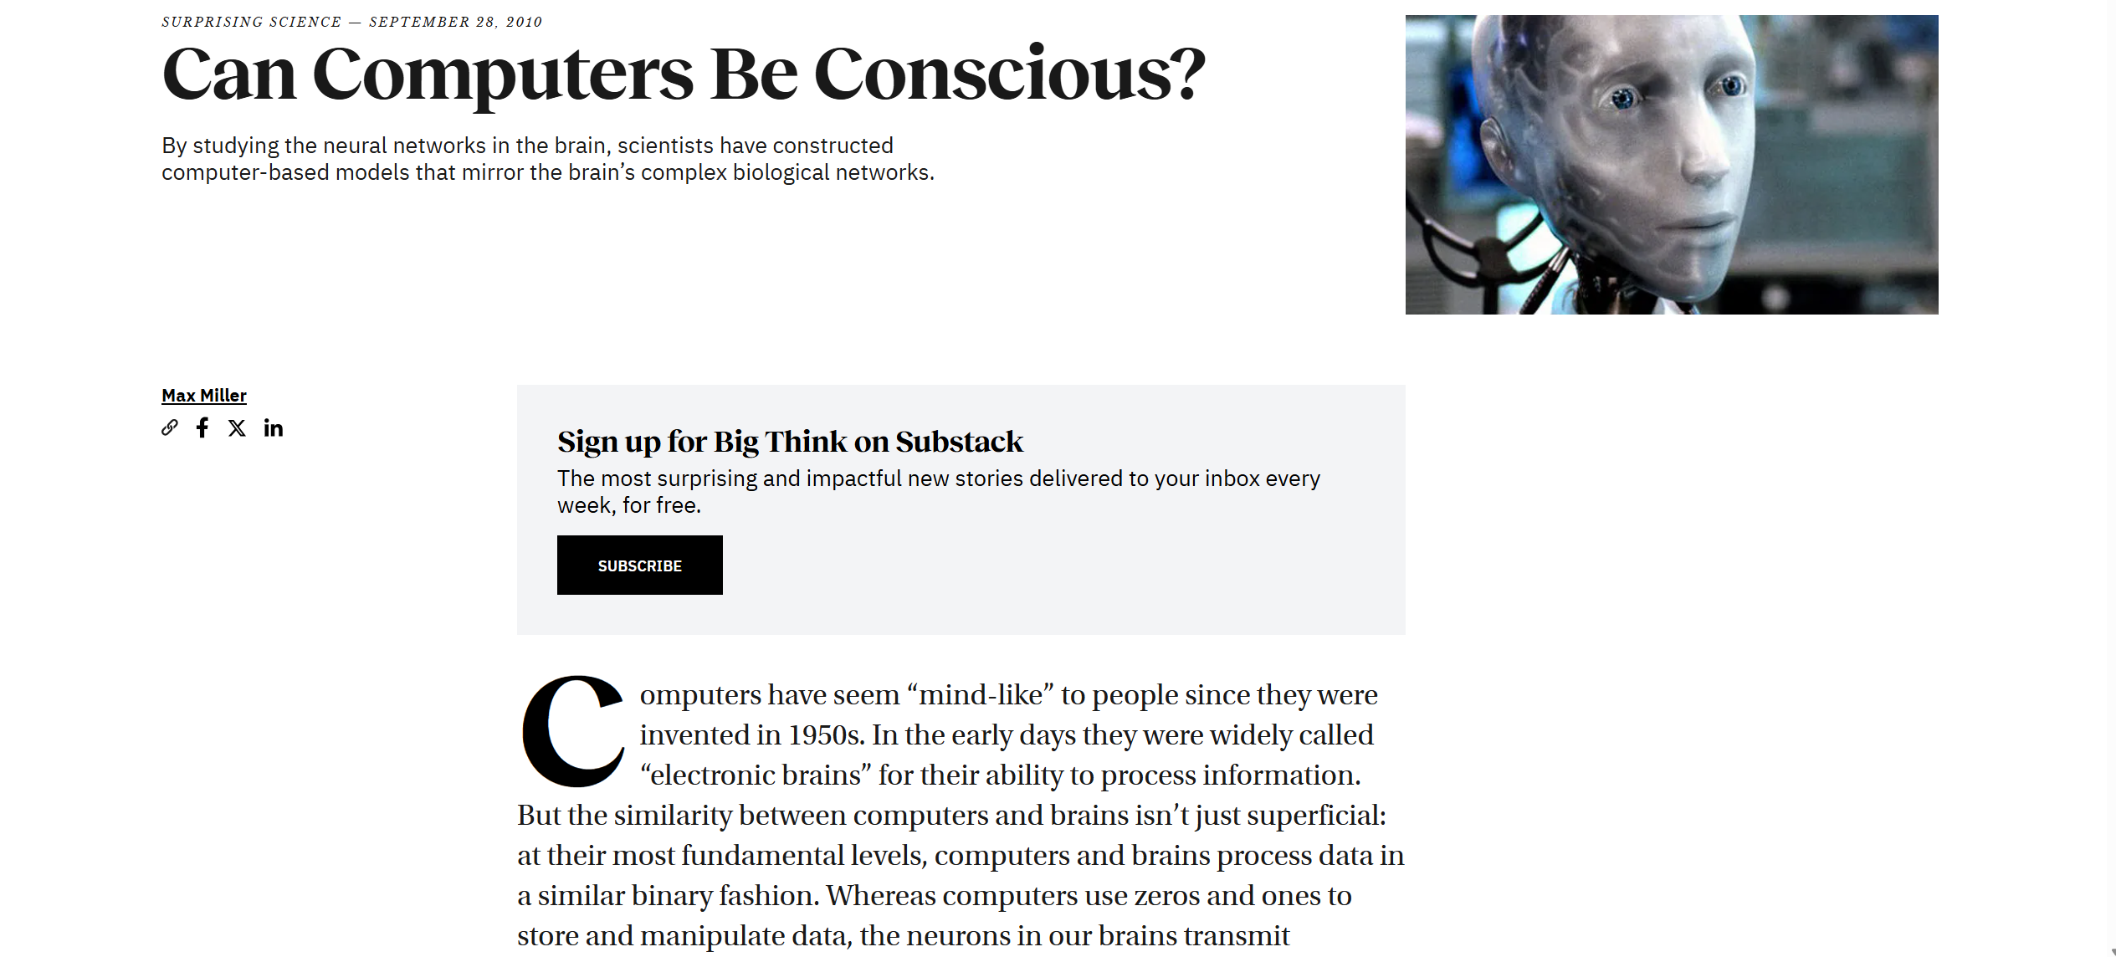
Author and Background
Article Structure
Vocabulary
Complex Sentences
Reading Skills
1.2 Article
https://bigthink.com/surprising-science/can-computers-be-conscious/
02

Slide 6
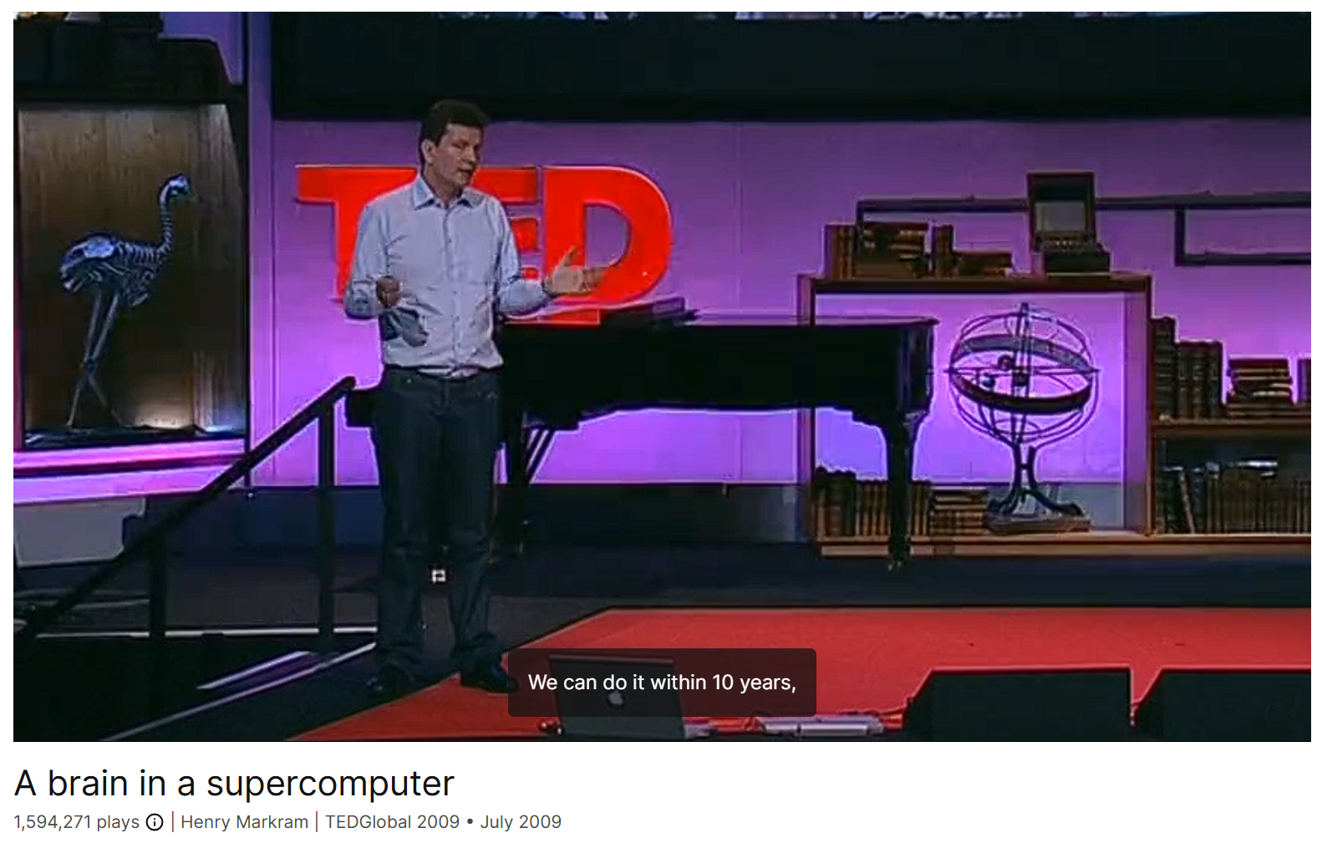
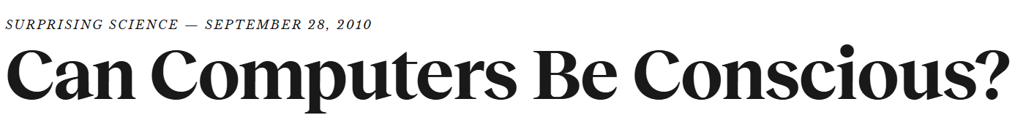
Complex Sentences
Reading Skills
研究背景及意义
研究现状及技术难点
结果分析与讨论
Author and Background
Article Structure
研究思路及研究方法
总结与展望
Vocabulary
1.3 Background
By studying the neural networks in the brain, scientists have constructed computer-based models that mirror the brain’s complex biological networks.
https://www.ted.com/talks/henry_markram_a_brain_in_a_supercomputer
03

Slide 7
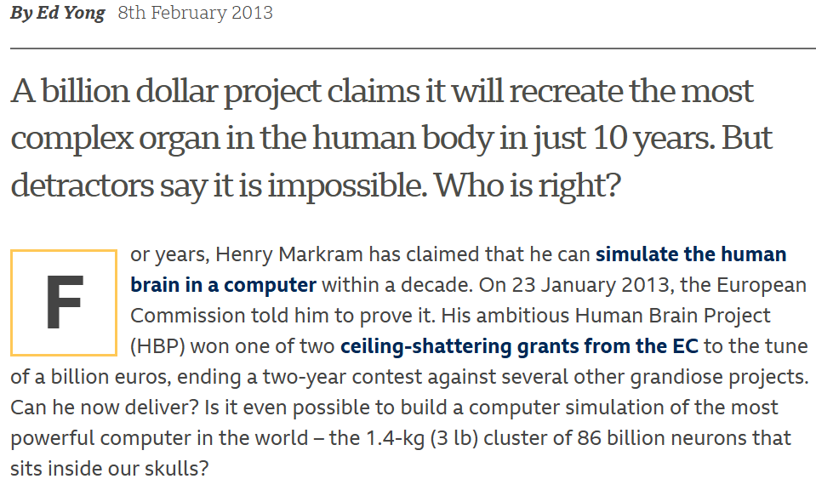
Complex Sentences
Reading Skills
研究背景及意义
研究现状及技术难点
结果分析与讨论
Author and Background
Article Structure
研究思路及研究方法
总结与展望
Vocabulary
1.4 Takeaway
The field of artificial intelligence has made only modest gains in recent decades, but new reverse-engineering projects hope to recreate virtual models of the brain. These computer simulations might help cure mental disorders as well as shed light on cognition and consciousness. Henry Markram’s Blue Brain Project has so far only recreated one neocortical column of a rat’s brain, but Markram believes a full human brain could be simulated within 10 years.
https://www.bbc.co.uk/future/article/20130207-will-we-ever-simulate-the-brain
04

Slide 8
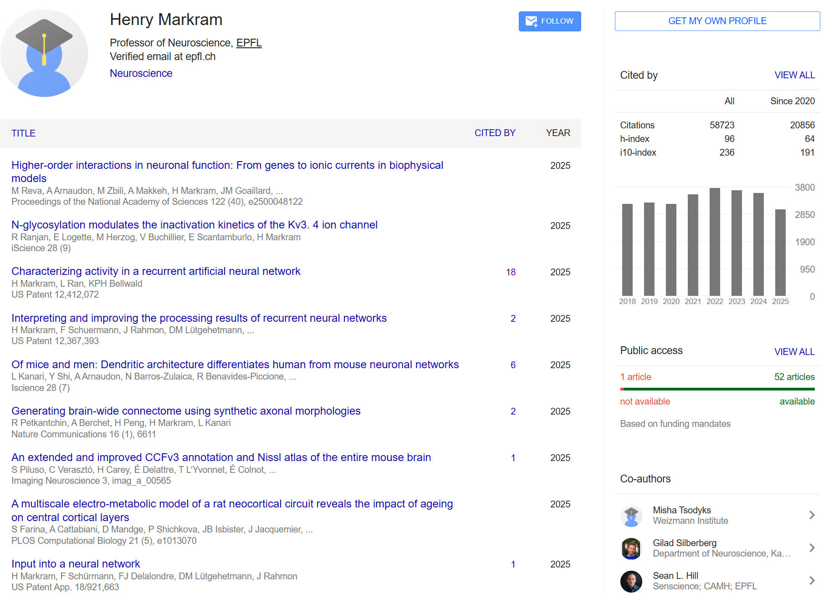
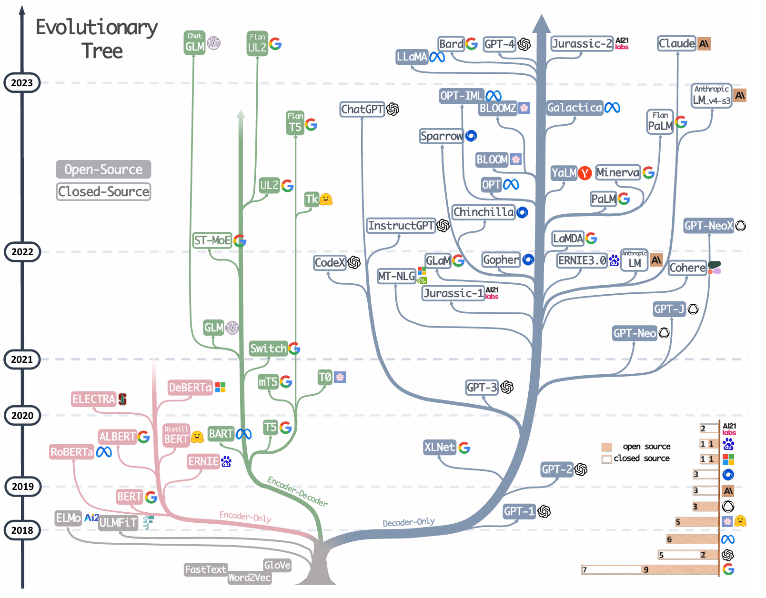
Complex Sentences
Reading Skills
研究背景及意义
研究现状及技术难点
结果分析与讨论
Author and Background
Article Structure
研究思路及研究方法
总结与展望
Vocabulary
1.4 Takeaway
Can Computers Be Conscious? It's hard to say.
https://scholar.google.com/citations?view_op=list_works&hl=en&hl=en&user=W3lyJF8AAAAJ&sortby=pubdate
05
https://arxiv.org/abs/2304.13712

Slide 9
2
Article Structure

Slide 10
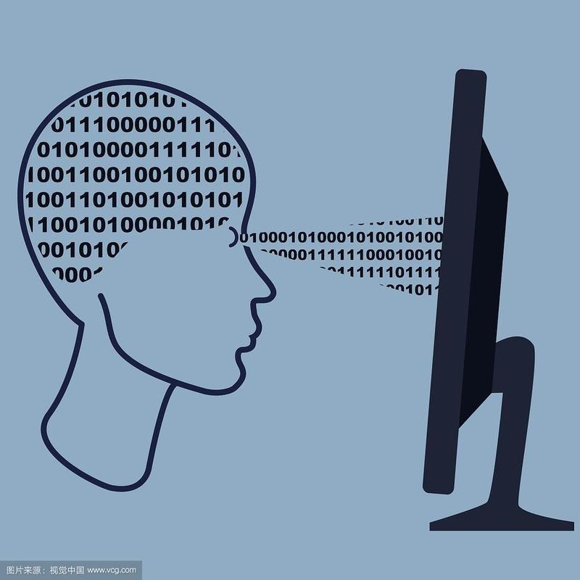
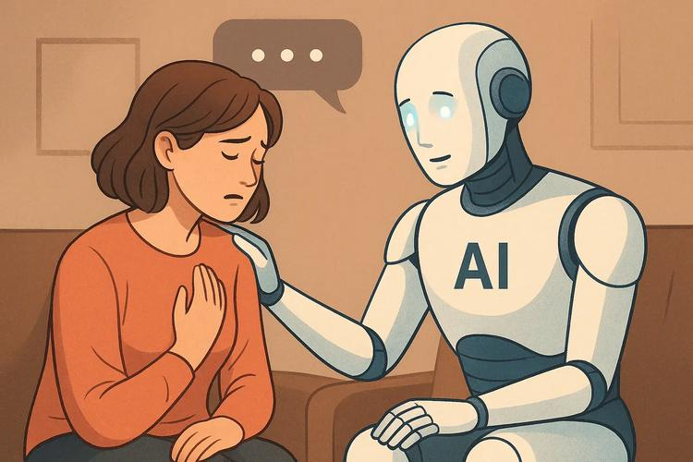
Author and Background
Article Structure
Vocabulary
Complex Sentences
Reading Skills
Because of the application of binary pattern, the computer produces "mind-like" characteristics, which becomes the basis of computational neuroscience.
Paras. 1
Section 1
graph 1 Binary diagram（视觉中国）
But AI has been slow to make breakthroughs in core technologies, such as simulating human consciousness and creativity.
？
Paras. 2
graph 2 AI and human（百度百科）
06

Slide 11
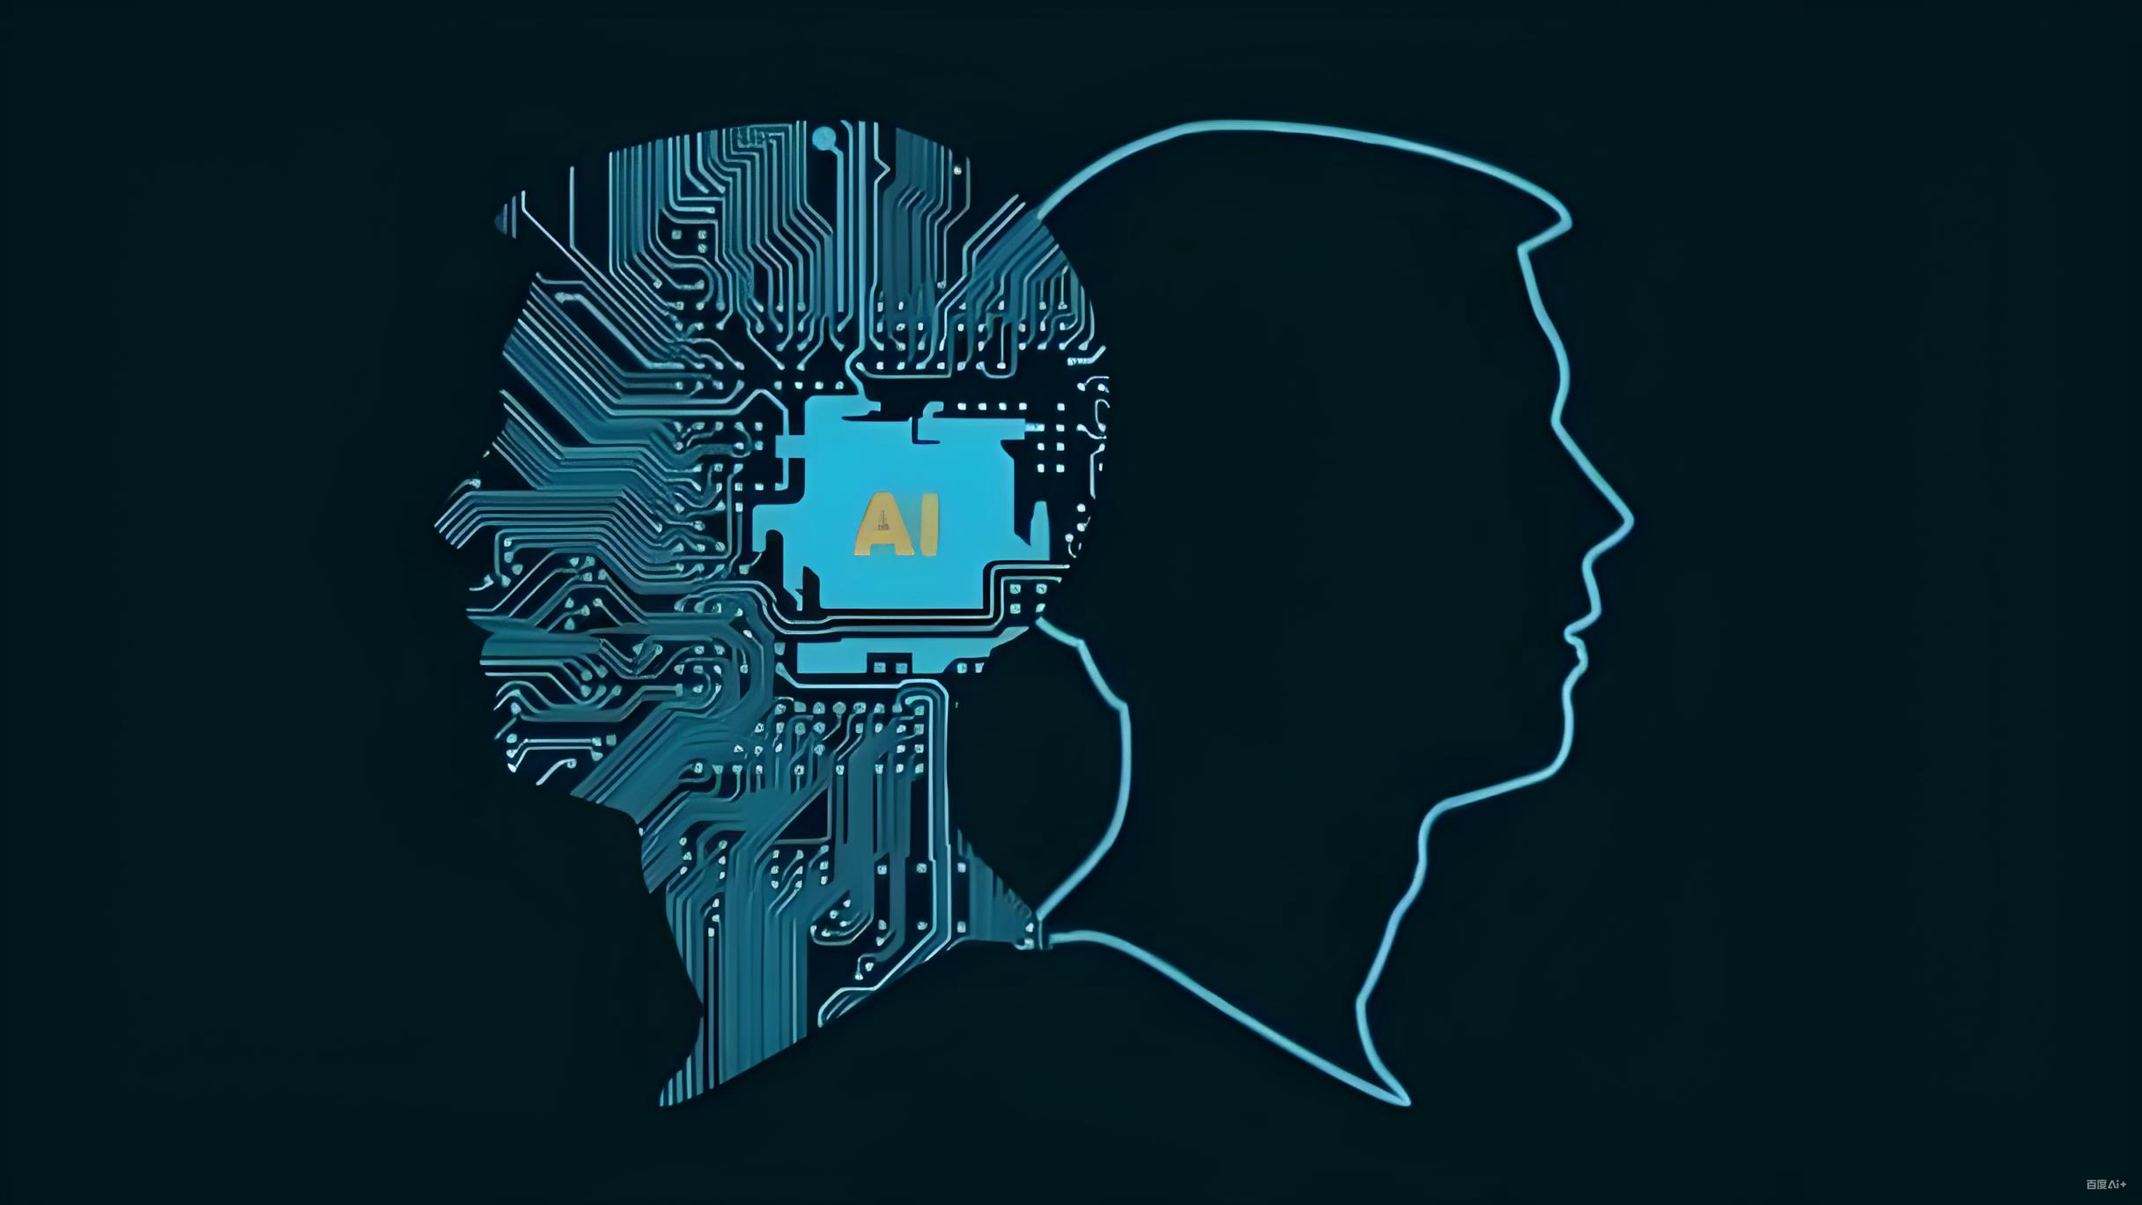
Author and Background
Article Structure
Vocabulary
Complex Sentences
Reading Skills
Section 2
Paras. 3-5
By introducing one major project which tries to make a computer model to replicate virtual brains,the author asks a question here: Will this modelbecome conscious itself ?
consciousness
？
graph 3 Virtual brain（百度百科）
07

Slide 12

Author and Background
Article Structure
Vocabulary
Complex Sentences
Reading Skills
Section 3
Paras. 6-10
Acquiring problem-solving and reasoning abilities cannot necessarily make a computer intelligent enough. Scientists realise how important it is to design a creative Al, a model that can invent new analogies and experience emotions the way humans do.And this is a long-term research direction in the future.
consciousness
graph 4 Creative AI（百度百科）
08

Slide 13
3
Vocabulary

Slide 14

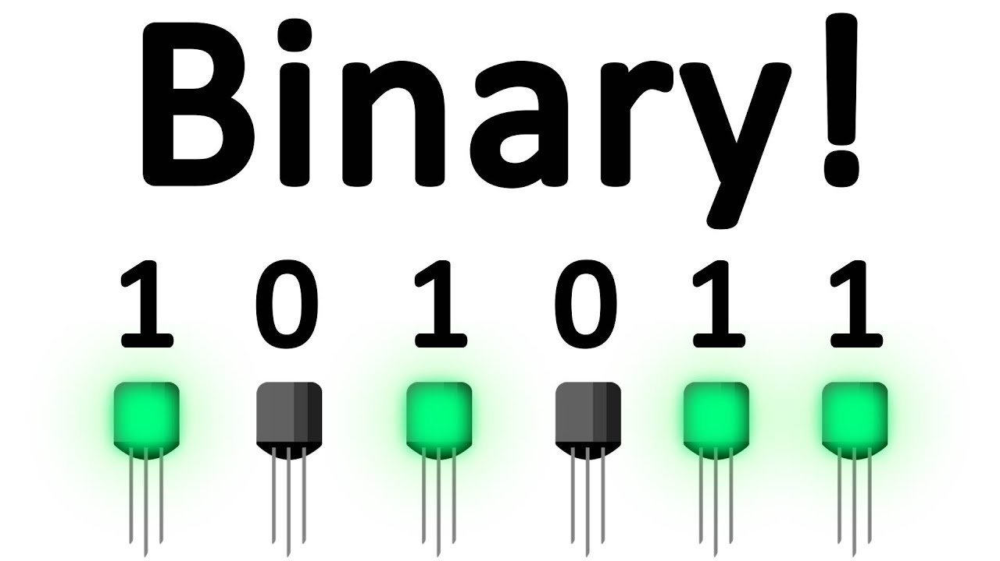
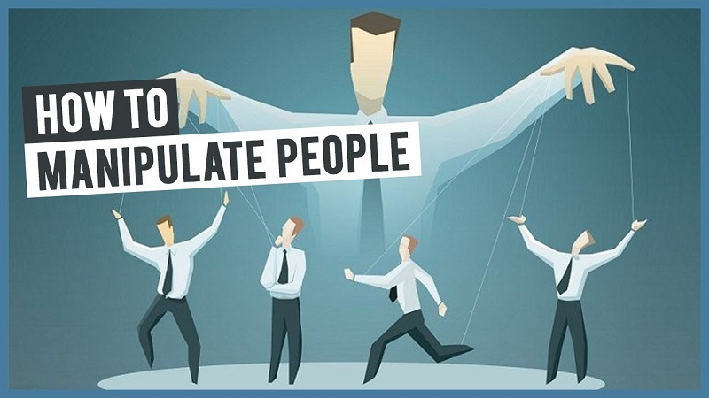

Author and Background
Article Structure
Vocabulary
Complex Sentences
Reading Skills
binary /'bainəri/adj.the binary system:a systemof counting,used in computers,in which only thenumbers 0 and 1 are used.
eg:Every beat is a one, every rest is a zero. Binary code.
manipulate /mə'nrpjylert/vt.to work skilfully withinformation,systems,etc.to achieve the result that you want
eg:Friends don't manipulate friends. They help each other.
burgeoning /'b3:d3oniŋ/adj.growing,increasing,or developing very quickly
eg:It's a burgeoning market, you're gonna make a fortune.
09

Slide 15
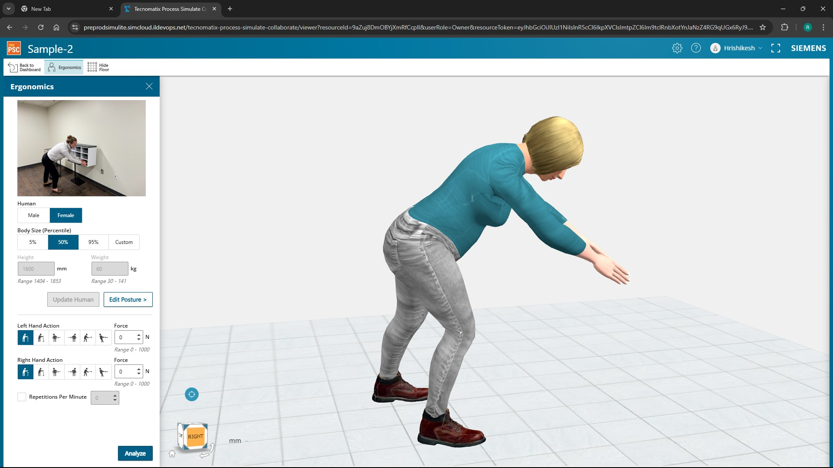
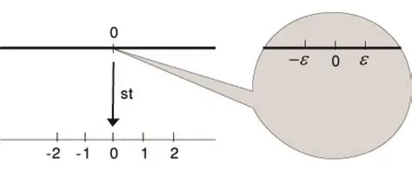
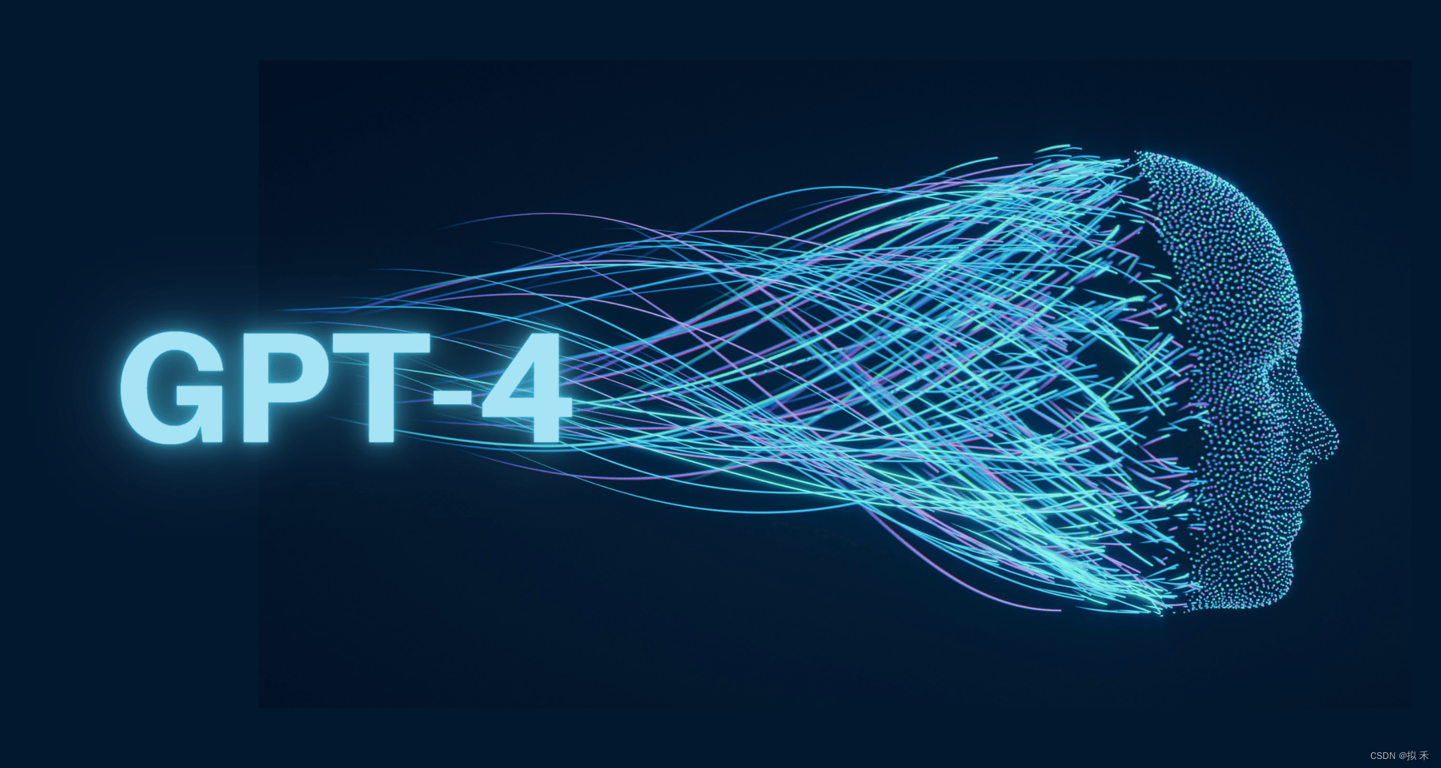
Author and Background
Article Structure
Vocabulary
Complex Sentences
Reading Skills
simulate /'simjylert/vt. to make or producesomething that is not real but has the appearanceor feeling of being real
eg: But I can simulate interest in your statements.
infinitesimal /infin'tesməl/adj.extremely small
eg:I told you, the odds of getting off this island are infinitesimal.
emergent /r'm3:d3ont/adj.(only before noun)in an early state of development
eg:But the fact of the matter is that what is going on is a kind of emergent complexity.
10

Slide 16


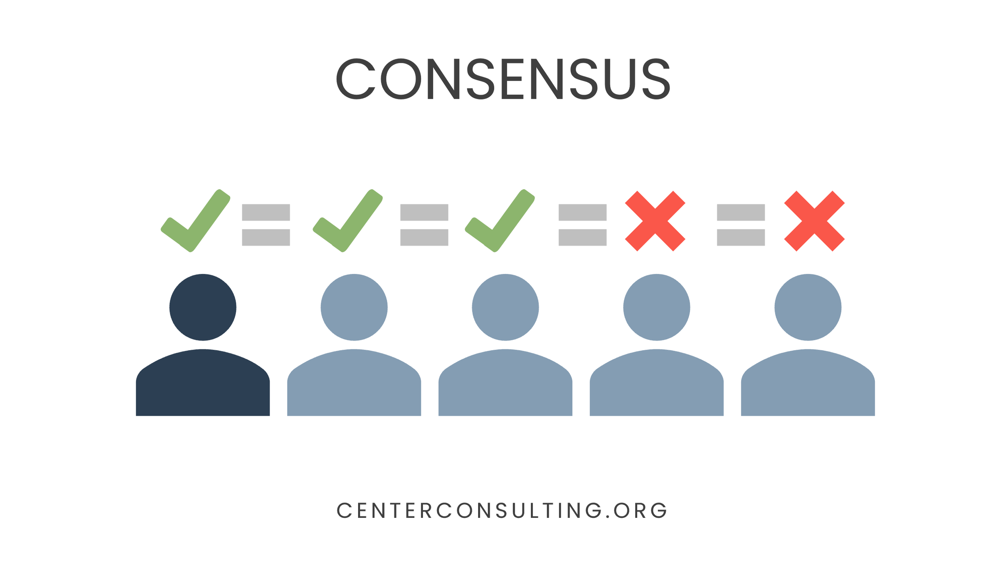
Author and Background
Article Structure
Vocabulary
Complex Sentences
Reading Skills
analogy /ə'nælədʒi/n.something that seemssimilar in two situations,processes,etc.
eg:Can you make an analogy that might help us understand?
haunt /hɔ:nt/vt.to cause problems for someoneover a long period of time
eg:I thought I would die here and haunt it ever after.
consensus /kən'sensəs/n.an opinion thateveryone in a group agrees with or accepts
eg:There's a town consensus about what kind of girl I am.
11

Slide 17


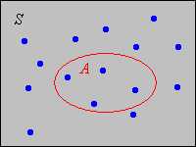
Author and Background
Article Structure
Vocabulary
Complex Sentences
Reading Skills
monopolise /mə'nppəlaiz/vt.to use a lot of someone's time or attention
eg:These are all world-class technology which used to be monopolised by Rolls-Royce.
subtle /'sʌtl/adj.not easy to notice or understand unless you pay careful attention
eg:The effect is so subtle, you'd never notice it.
discrete /dr'skri:t/adj.clearly separate
eg:This damage was not caused by a discrete event.
12

Slide 18

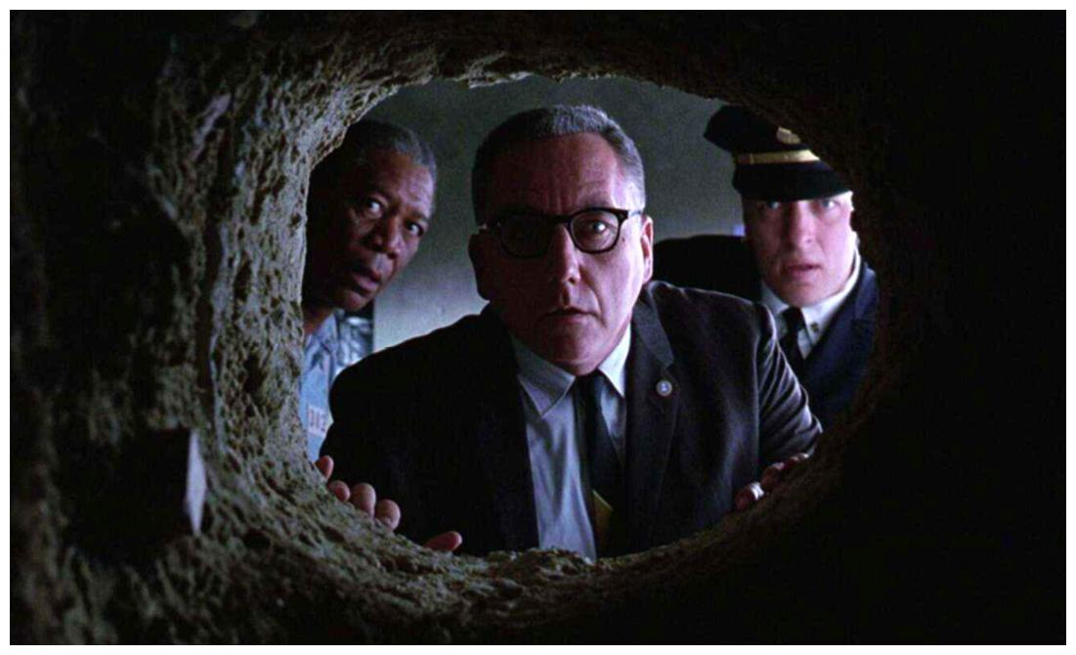
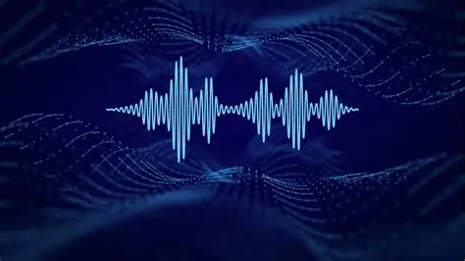
Author and Background
Article Structure
Vocabulary
Complex Sentences
Reading Skills
remnant /'remnənt/n.a small part of something that remains after the rest of it has been used,destroyed,or eaten
eg:I found these food remnants between the victim's teeth. See this?
nuanced /'njua:nst/adj.slightly different
eg:Since then the distinction between animals and humans has become increasingly nuanced.
resonance /'rezənəns/n.the special meaning or importance that something has for you because itrelates to your own experiences
eg:There must be some resonance between the elements I didn't know about.
13

Slide 19
4
Complex Sentences

Slide 20
Author and Background
Article Structure
Vocabulary
Complex Sentences
Reading Skills
Para.1 / Sentence 1
Whereas computers use zeros and ones to store and manipulate data, the neurons in our brains transmit information in binary, on/off spikes known as action potentials.
Para.1 / Sentence 2
This basic similarity is what underlies the burgeoning field of computational neuroscience, which hopes to understand how neuronal networks give rise to processes like memory and facial recognition.
Para.4 / Sentence 4
If they could accurately recreate the behaviours and structures of a biological brain, their computer simulation should shed light on both normal cognition and disorders.
14
Notes:
In this session, we will look at three sentences that show different parts of English grammar. We'll start by looking at how each sentence is put together and then talk about how understanding these structures can improve your writing.

Slide 21
Author and Background
Article Structure
Vocabulary
Complex Sentences
Reading Skills
1. Contrast Structure (Whereas)
Para.1 / Sentence 1
Whereas computers use zeros and ones to store and manipulate data, the neurons in our brains transmit information in binary, on/off spikes known as action potentials.
Key Grammar Points:
· Whereas = introduces contrast (like “while” or “although”)
· Main clause vs. Subordinate clause
(M) the neurons in our brains transmit information in binary
(S) Whereas computers use zeros and ones...
15
Notes:
Let’s start with the first sentence: 'Whereas computers use zeros and ones to store and process data, the neurons in our brains send information through on/off spikes called action potentials.’
Does everyone know how to translate this sentence?
计算机使用0和1来存储、处理数据，而我们大脑中的神经元则以二进制形式的开/关尖峰来传输信息，这些尖峰被称为动作电势。
This sentence uses 'whereas' to show a contrast between how computers and neurons handle information. Also, notice how 'known as' is used to explain what action potentials are.

Slide 22
Author and Background
Article Structure
Vocabulary
Complex Sentences
Reading Skills
Computers vs. Neurons: Two Ways to Process Information
Computers | Neurons
Use 0s and 1s | Use on/off spikes
Store data digitally | Transmit via action potentials
Caption: “Whereas” highlights this difference!
16
Notes:
Here’s a visual showing the two ways information is processed, as mentioned in the sentence. This helps us see the clear difference being made.

Slide 23
Author and Background
Article Structure
Vocabulary
Complex Sentences
Reading Skills
2. Noun Clause & Non-restrictive Relative Clause
Para.1 / Sentence 2
This basic similarity is what underlies the burgeoning field of computational neuroscience, which hopes to understand how neuronal networks give rise to processes like memory and facial recognition.
Key Grammar Points:
what underlies... = noun clause ( = “the thing that underlies...”) → acts as subject complement
which hopes to... = non-restrictive relative clause (adds extra info; refers to “field”)
17
Notes:
Our second sentence: 'This basic similarity is the foundation of the growing field of computational neuroscience, which aims to understand how brain networks lead to processes like memory and facial recognition.’
(两者之间的)这一基本的相似性奠定了新兴的计算神经科学领域的基础，该学科希望了解神经元网络是如何完成记忆和面部识别等过程的，以便将它们复制到智能机器中。
In this sentence, 'what' introduces a noun clause that acts as the subject complement, and 'which' starts a non-restrictive relative clause that adds extra information about computational neuroscience.

Slide 24
Author and Background
Article Structure
Vocabulary
Complex Sentences
Reading Skills
Examples to illustrate:
1. This is what I meant. → (= the thing that I meant)
2. She invented AI, which can recognize faces. → (extra info about AI)
Tip: Non-restrictive clauses are always set off by commas!
18
Notes:
To make it clearer, here are some easier examples of 'what' clauses and non-restrictive relative clauses.

Slide 25
Author and Background
Article Structure
Vocabulary
Complex Sentences
Reading Skills
3. Hypothetical Conditional
Para.4 / Sentence 4
If they could accurately recreate the behaviours and structures of a biological brain, their computer simulation should shed light on both normal cognition and disorders like depression and schizophrenia.
Key Grammar Points:
If + could... → unreal/hypothetical condition (not real now)
should = formal way to say “would” (predicts result)
Structure: If + past subjunctive (could/were), ... would/should + base verb
19
Notes:
Finally, let’s look at this sentence: If they could accurately recreate the behaviours and structures of a biological brain, their computer simulation should shed light on both normal cognition and disorders like depression and schizophrenia.’
如果他们能够准确地再现生物大脑的行为和结构，他们的计算机模拟便可阐释正常的大脑认知功能和诸如抑郁症、精神分裂症等疾病。
This is an example of a virtual conditional, where 'if + could' creates a hypothetical situation, and 'could' predicts the result.

Slide 26
5
Reading Skills

Slide 27
Author and Background
Article Structure
Vocabulary
Complex Sentences
Reading Skills
What are arguments ?
In the context of critical thinking,arguments mean the presentation of evidence to support a claim.Therefore,an argument consists of two parts;one part supposedly provides a reason for thinking that other part is true.
Evidence
Claim
Argument
20

Slide 28
Author and Background
Article Structure
Vocabulary
Complex Sentences
Reading Skills
How to support a claim with evidence ?
Presenting and explaining statistics
Statistics will be used to convey information in a numerical form (referred to as data). Statistics are convincing when they are used in combination with an explanation of why the numbers are significant.
Providing appropriate examples
Examples can support the writer’s contention that a general statement is true and provide specifics and details in support of a claim.
Quoting expert opinions
Expert opinions are usually based on factual evidence to interpret other facts.
21

Slide 29
Author and Background
Article Structure
Vocabulary
Complex Sentences
Reading Skills
Determine which of the following passages contain arguments
Asked whether there will ever be computers as smart as people, the US mathematician and sci-fi author Vernor Vinge replied: “Yes, but only briefly.” He meant that once computers get to this level, there’s nothing to prevent them getting a lot further very rapidly.
No argument
Asked whether there will ever be computers as smart as people, the US mathematician and sci-fi author Vernor Vinge replied: “Yes, but only briefly.” He meant that once computers get to this level, there’s nothing to prevent them getting a lot further very rapidly.
Only have claim without evidence
22

Slide 30
Author and Background
Article Structure
Vocabulary
Complex Sentences
Reading Skills
Determine which of the following passages contain arguments
One by one, computers take over domains that were previously considered off-limits to anything but human intellect and intuition. We now have machines that have trumped human performance in such domains as chess, trivia games, flying, driving, financial trading, face, speech and handwriting recognition – the list goes on.
Argument
One by one, computers take over domains that were previously considered off-limits to anything but human intellect and intuition. We now have machines that have trumped human performance in such domains as chess, trivia games, flying, driving, financial trading, face, speech and handwriting recognition – the list goes on.
23

Slide 31
Author and Background
Article Structure
Vocabulary
Complex Sentences
Reading Skills
Determine which of the following passages contain arguments
By default, then, we seem to have no reason to think that intelligent machines would share our values. The good news is that we probably have no reason to think they would be hostile, as such: Hostility, too, is an animal emotion.
Argument
By default, then, we seem to have no reason to think that intelligent machines would share our values. The good news is that we probably have no reason to think they would be hostile, as such: Hostility, too, is an animal emotion.
24

Slide 32
Author and Background
Article Structure
Vocabulary
Complex Sentences
Reading Skills
Determine which of the following passages contain arguments
There are real dangers from AI but they tend to be economic and social in nature. Clever AI will create tremendous wealth for society, but will leave many people without jobs. Unlike the industrial revolution, there may not be jobs for segments of society as machines may be better at every possible job.
Argument
There are real dangers from AI but they tend to be economic and social in nature. Clever AI will create tremendous wealth for society, but will leave many people without jobs. Unlike the industrial revolution, there may not be jobs for segments of society as machines may be better at every possible job.
25

Slide 33
This concludes the report.
Thank you for watching.
Topic：Computer
Reporter：Team 5
2025.12.11

